Slide 1
Recurrence

Slide 2
Recurrence
A Recurrence algorithm is a method of describing complex problems using a number of repeatable operations.
Recurrence is a commonly used algorithm in sequence calculations, usually by calculating some previous items to obtain the value of a specified item in the sequence.
The Recurrence algorithm is a simple algorithm, that is, an algorithm that uses specific relationships to draw intermediate inferences through known conditions until the result is obtained.
There are two types of Recurrence algorithms: forward and reverse.

Slide 3
Two elements of the Recurrence algorithm
Analyse the problem and derive the Recurrence relationship (Recurrence equation) and initial values.
Determine the order of Recurrence.

Slide 4

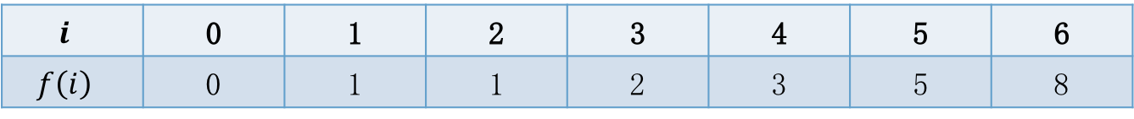
Fibonacci Sequence
$f\left(i\right)$ is the $i$-th Fibonacci number, the Recurrence relationship and initial values are as follows:
$$f\left(0\right)=0$$
$$f\left(1\right)=1$$
$$f\left(i\right)=f\left(i−1\right)+f(i−2)$$
Recurrence order: $i$ascending
$$i$$ | 0 | 1 | 2 | 3 | 4 | 5 | 6
$$f\left(i\right)$$ | 0 | 1 | 1 | 2 | 3 | 5 | 8

Slide 5

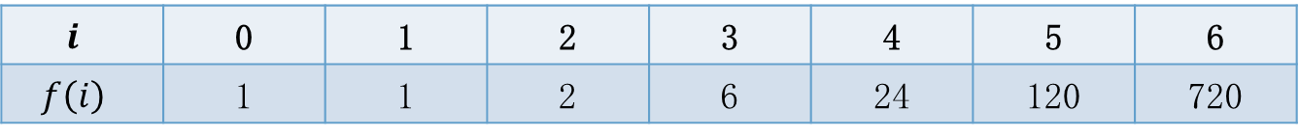
factorial
$f\left(i\right)$ is the factorial of $\left.i\right.$, Recurrence relation and initial value:
$$f\left(0\right)=1$$
$$f\left(i\right)=i∗f\left(i−1\right)$$
Recurrence order: $i$ ascending
$$i$$ | 0 | 1 | 2 | 3 | 4 | 5 | 6
$$f\left(i\right)$$ | 1 | 1 | 2 | 6 | 24 | 120 | 720

Slide 6

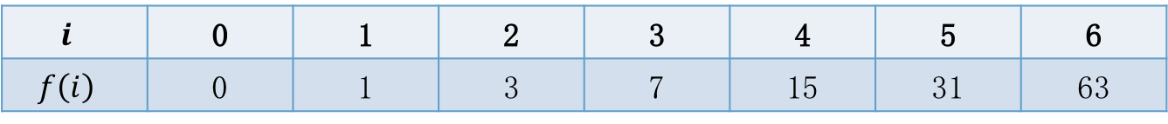
Tower of Hanoi
$f\left(i\right)$ is the number of moves needed for moving a Tower of $i$discs:
$$f\left(0\right)=0$$
$$f\left(1\right)=1$$
$$f\left(i\right)=2∗f\left(i−1\right)+1$$
Recurrence order: $i$ascending
$$i$$ | 0 | 1 | 2 | 3 | 4 | 5 | 6
$$f\left(i\right)$$ | 0 | 1 | 3 | 7 | 15 | 31 | 63

Slide 7
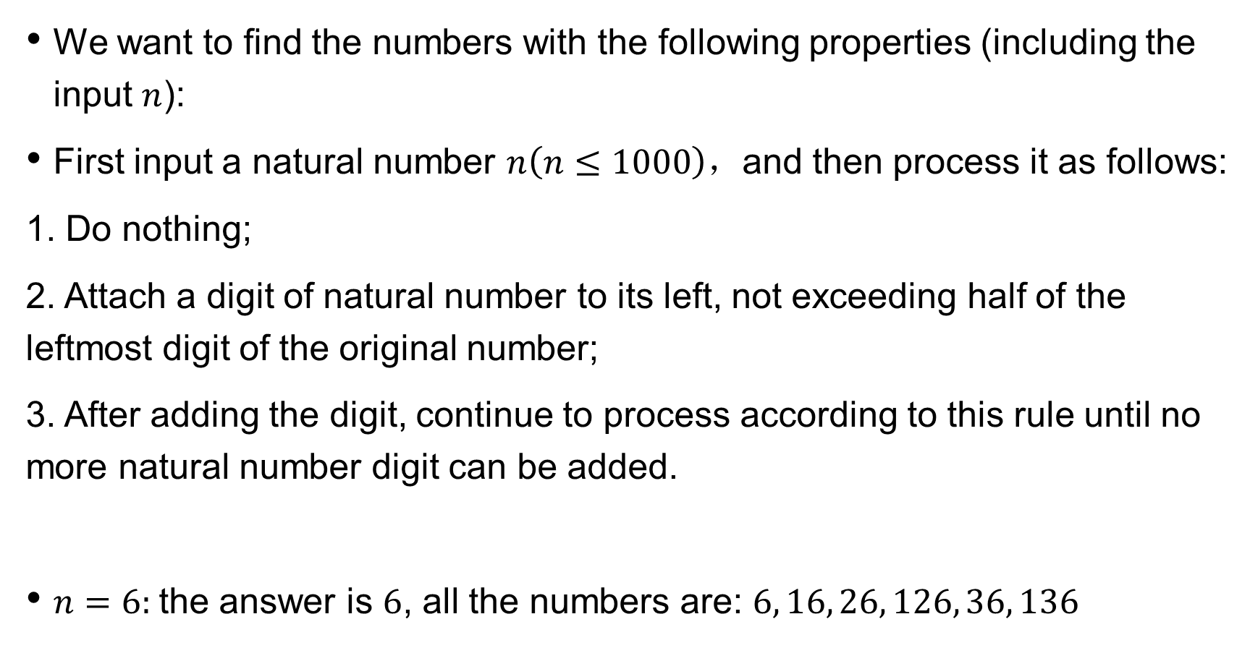
counting of numbers
We want to find the numbers with the following properties (including the input $n$):
First input a natural number $n\left(n≤1000\right)，$and then process it as follows:
1. Do nothing;
2. Attach a digit of natural number to its left, not exceeding half of the leftmost digit of the original number;
3. After adding the digit, continue to process according to this rule until no more natural number digit can be added.
$n=6:$the answer is $6$, all the numbers are: $6, 16, 26, 126, 36, 136$

Slide 8

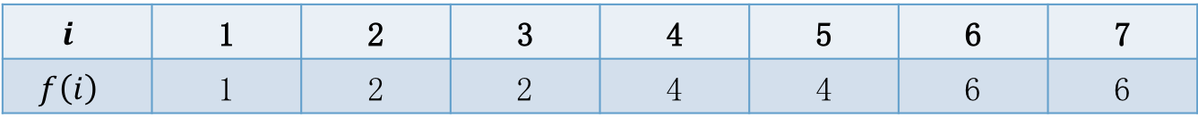
counting of numbers
$f\left(i\right)$ is the answer when $n= i$
$$f\left(1\right)=1$$
$$f\left(i\right)=1+f\left(i/2\right)+f\left(i/2−1\right)+…+f\left(1\right)=1+\sum_{k=1}^{i/2}{f(k)}$$
Recurrence order: $i$ ascending
$$i$$ | 1 | 2 | 3 | 4 | 5 | 6 | 7
$$f\left(i\right)$$ | 1 | 2 | 2 | 4 | 4 | 6 | 6

Slide 9
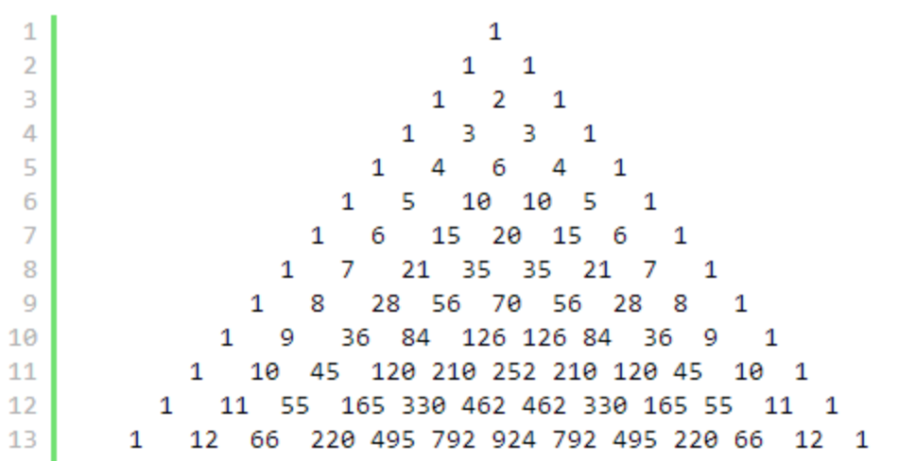
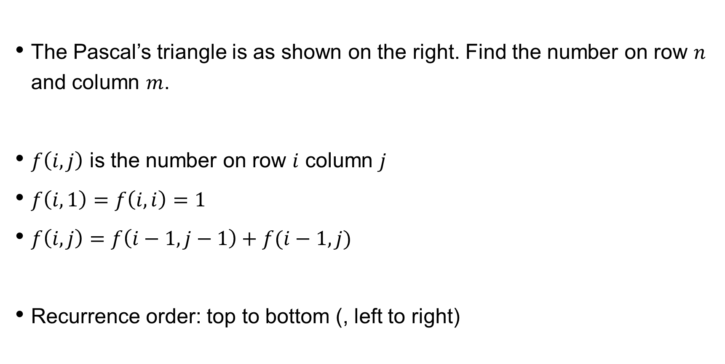
Pascal’s triangle
The Pascal’s triangle is as shown on the right. Find the number on row $n$ and column $m$.
$f\left(i,j\right)$ is the number on row $i$ column $j$
$f\left(i,1\right)=f\left(i,i\right)=1$
$f\left(i,j\right)=f\left(i−1,j−1\right)+f(i−1,j)$
Recurrence order: top to bottom (, left to right)

Slide 10
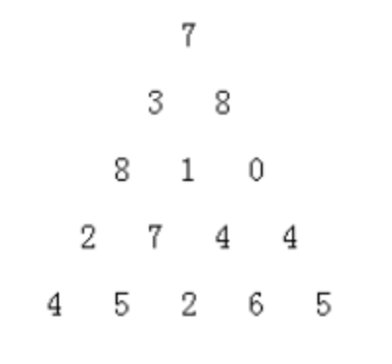
bowling
Some bowling pins are arranged in the shape of an equilateral triangle (as shown in the figure below), N rows high. Each pin is marked with a positive number ( 1-99 ). Now start from the top and push down the bowling pins. The rule is that after each pin falls, it brings down the adjacent left or right bottle on the next layer until you reach the bottom layer.
Find the maximum possible value of the sum of the integers on all the bottles that have fallen down.

Slide 11
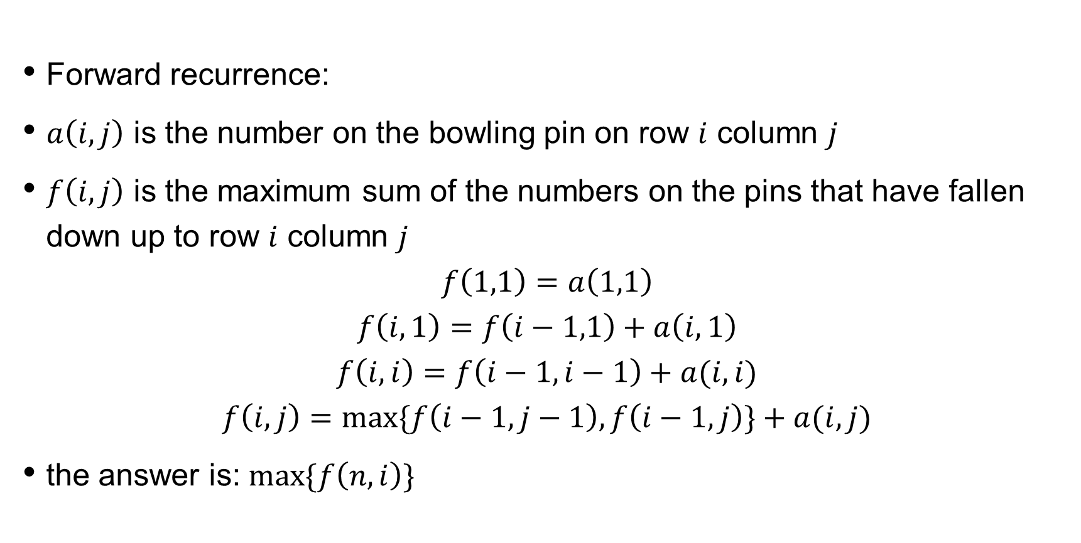
bowling
Forward recurrence:
$a\left(i,j\right)$ is the number on the bowling pin on row $i$ column $j$
$f\left(i,j\right)$ is the maximum sum of the numbers on the pins that have fallen down up to row $i$ column $j$
$$f\left(1,1\right)=a\left(1,1\right)$$
$$f\left(i,1\right)=f\left(i−1,1\right)+a\left(i,1\right)$$
$$f\left(i,i\right)=f\left(i−1,i−1\right)+a(i,i)$$
$$f\left(i,j\right)=\max{\{f\left(i−1,j−1\right),f\left(i−1,j\right)\}}+a(i,j)$$
the answer is: $\max{\{f\left(n,i\right)\}}$

Slide 12
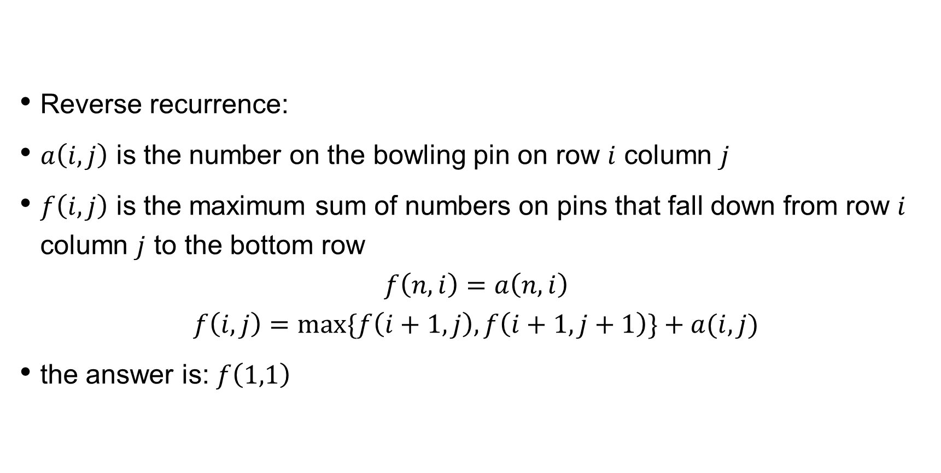
bowling
Reverse recurrence:
$a\left(i,j\right)$ is the number on the bowling pin on row $i$ column $j$
$f\left(i,j\right)$ is the maximum sum of numbers on pins that fall down from row $i$ column $j$ to the bottom row
$$f\left(n,i\right)=a\left(n,i\right)$$
$$f\left(i,j\right)=\max{\{f\left(i+1,j\right),f\left(i+1,j+1\right)\}}+a(i,j)$$
the answer is: $f\left(1,1\right)$

Slide 13
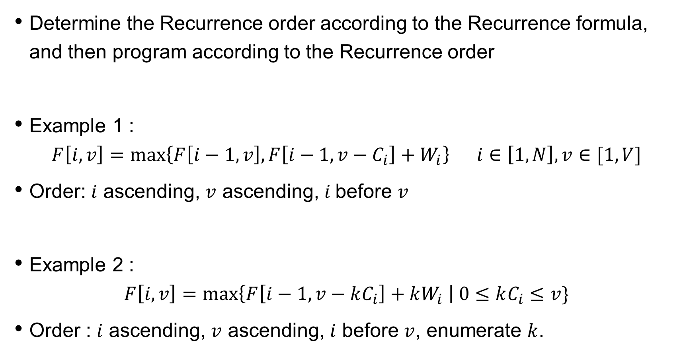
Write a program based on the Recurrence formula
Determine the Recurrence order according to the Recurrence formula, and then program according to the Recurrence order
Example 1 :
$$F\left[i,v\right]=max\left\{F\left[i−1,v\right],F\left[i−1,v−C_{i}\right]+W_{i}\right\} i∈\left[1,N\right],v∈[1,V]$$
Order: $i$ ascending, $v$ ascending, $i$before $v$
Example 2 :
$$F\left[i,v\right]=max\left\{F\left[i−1,v−kC_{i}\right]+kW_{i} \right| 0≤kC_{i}≤v\}$$
Order : $i$ ascending, $v$ ascending, $i$ before $v$, enumerate $k$.

Slide 14
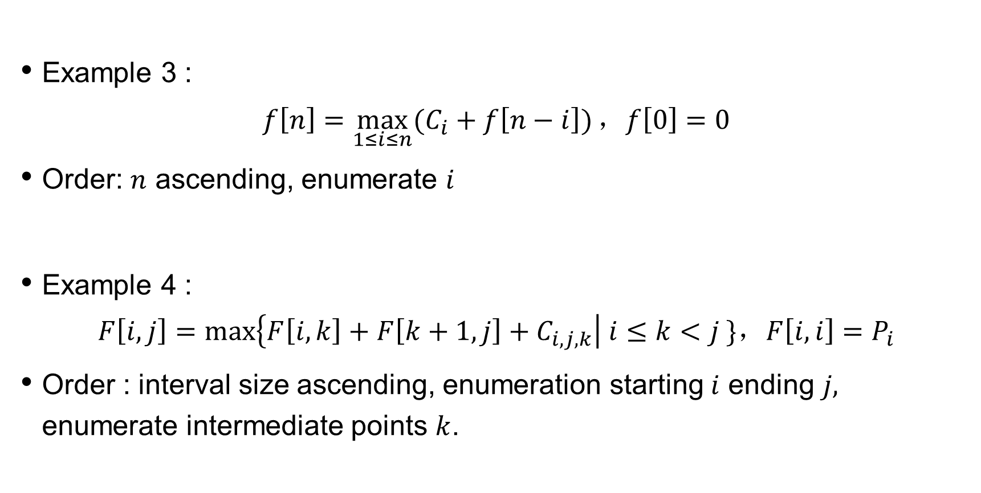
Write a program based on the Recurrence formula
Example 3 :
$$f\left[n\right]=\max_{1≤i≤n}{(C_{i}+f\left[n−i\right])}\text{，}f\left[0\right]=0$$
Order: $n$ ascending, enumerate $i$
Example 4 :
$$F\left[i,j\right]=max\left\{F\left[i,k\right]+F\left[k+1,j\right]+C_{i,j,k}\right| i≤k<j \}\text{，}F\left[i,i\right]=P_{i}$$
Order : interval size ascending, enumeration starting $i$ ending $j,$ enumerate intermediate points $k$.

